Slide 1
DevOps Containerization using Docker
Rahul,
solution architect, Oracle

Slide 2
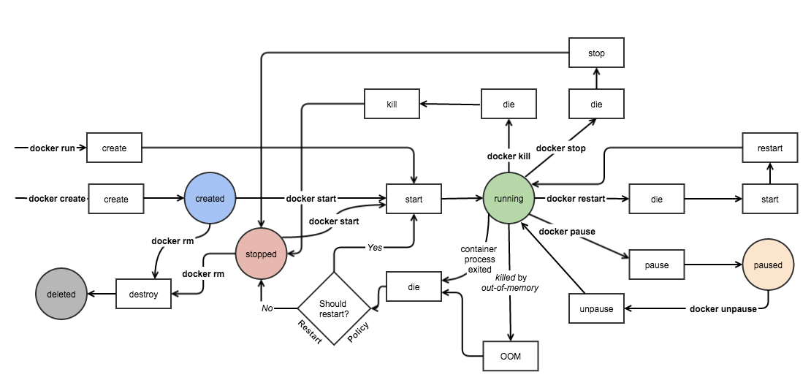
Docker Container Lifecycle

Slide 3
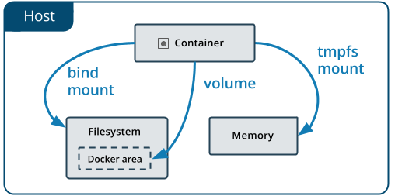
Docker Volumes : Managing Data in Docker

Slide 4
Types of Mounts in Docker
Volumes are stored in a part of the host filesystem which is managed by Docker(/var/lib/docker/volumes/ on Linux).
Non-Docker processes should not modify this part of the filesystem.
Volumes are the best way to persist data in Docker.
Bind mounts may be stored anywhere on the host system.
They may even be important system files or directories.
Non-Docker processes on the Docker host or a Docker container can modify them at any time.
tmpfs mounts are stored in the host system’s memory only, and are never written to the host system’s filesystem.

Slide 5
Docker : Volumes
Volumes: Created and managed by Docker. You can create a volume explicitly using the docker volume create command, or Docker can create a volume during container or service creation.
When you create a volume, it is stored within a directory on the Docker host. When you mount the volume into a container, this directory is what is mounted into the container. This is similar to the way that bind mounts work, except that volumes are managed by Docker and are isolated from the core functionality of the host machine.
A given volume can be mounted into multiple containers simultaneously. When no running container is using a volume, the volume is still available to Docker and is not removed automatically. You can remove unused volumes using docker volume prune.
When you mount a volume, it may be named or anonymous. Anonymous volumes are not given an explicit name when they are first mounted into a container, so Docker gives them a random name that is guaranteed to be unique within a given Docker host. Besides the name, named and anonymous volumes behave in the same ways.
Volumes also support the use of volume drivers, which allow you to store your data on remote hosts or cloud providers, among other possibilities.

Slide 6
Docker : Bind Mounts
Available since the early days of Docker. Bind mounts have limited functionality compared to volumes.
When you use a bind mount, a file or directory on the host machine is mounted into a container.
The file or directory is referenced by its full path on the host machine. The file or directory does not need to exist on the Docker host already.
It is created on demand if it does not yet exist.
Bind mounts are very performant, but they rely on the host machine’s filesystem having a specific directory structure available.
If you are developing new Docker applications, consider using named volumes instead. You can’t use Docker CLI commands to directly manage bind mounts.

Slide 7
Docker : tmpfs
A tmpfs mount is not persisted on disk, either on the Docker host or within a container.
It can be used by a container during the lifetime of the container, to store non-persistent state or sensitive information.
For instance, internally, swarm services use tmpfsmounts to mount secrets into a service’s containers.

Slide 8
Use cases for Volumes
Volumes are the preferred way to persist data in Docker containers and services. Some use cases for volumes include:
Sharing data among multiple running containers. If you don’t explicitly create it, a volume is created the first time it is mounted into a container.
When that container stops or is removed, the volume still exists.
Multiple containers can mount the same volume simultaneously, either read-write or read-only. Volumes are only removed when you explicitly remove them.
When the Docker host is not guaranteed to have a given directory or file structure.
Volumes help you decouple the configuration of the Docker host from the container runtime.
When you want to store your container’s data on a remote host or a cloud provider, rather than locally.
When you need to back up, restore, or migrate data from one Docker host to another, volumes are a better choice. You can stop containers using the volume, then back up the volume’s directory (such as /var/lib/docker/volumes/<volume-name>).

Slide 9
Use cases for Bind Mounts
In general, you should use volumes where possible. Bind mounts are appropriate for the following types of use case:
Sharing configuration files from the host machine to containers.
This is how Docker provides DNS resolution to containers by default, by mounting /etc/resolv.conf from the host machine into each container.
Sharing source code or build artifacts between a development environment on the Docker host and a container.
For instance, you may mount a Maven target/ directory into a container, and each time you build the Maven project on the Docker host, the container gets access to the rebuilt artifacts.
If you use Docker for development this way, your production Dockerfile would copy the production-ready artifacts directly into the image, rather than relying on a bind mount.
When the file or directory structure of the Docker host is guaranteed to be consistent with the bind mounts the containers require.

Slide 10
Use cases for tmpfs mounts
tmpfs mounts are best used for cases when you do not want the data to persist either on the host machine or within the container.
This may be for security reasons or to protect the performance of the container when your application needs to write a large volume of non-persistent state data.

Slide 11
What to use Bind mounts or Volumes ?
If you use either bind mounts or volumes, keep the following in mind:
If you mount an empty volume into a directory in the container in which files or directories exist, these files or directories are propagated (copied) into the volume. Similarly, if you start a container and specify a volume which does not already exist, an empty volume is created for you. This is a good way to pre-populate data that another container needs.
If you mount a bind mount or non-empty volume into a directory in the container in which some files or directories exist, these files or directories are obscured by the mount, just as if you saved files into /mnt on a Linux host and then mounted a USB drive into /mnt. The contents of /mnt would be obscured by the contents of the USB drive until the USB drive were unmounted. The obscured files are not removed or altered, but are not accessible while the bind mount or volume is mounted.

Slide 12
Docker Compose
Compose is a tool for defining and running multi-container Docker applications.
With Compose, you use a YAML file to configure your application’s services.
Then, with a single command, you create and start all the services from your configuration.

Slide 13
Docker Compose in Action
Using Compose is basically a three-step process:
Define your app’s environment with a Dockerfile so it can be reproduced anywhere.
Define the services that make up your app in docker-compose.yml so they can be run together in an isolated environment.
Run docker-compose up and Compose starts and runs your entire app.

Slide 14
Installing and Uninstalling Docker Compose
Installing Docker Compose
sudo curl -L https://github.com/docker/compose/releases/download/1.21.2/docker-compose-$(uname -s)-$(uname -m) -o /usr/local/bin/docker-compose
sudo chmod +x /usr/local/bin/docker-compose
docker-compose –version
Uninstalling Docker Compose
sudo rm /usr/local/bin/docker-compose

Slide 15
Thank You
Subscribe our channel for Next Video on Virtualization

